Slide 1
Variable/MODEL selection
Sunil Mathew

Slide 2
Agenda
R components used
Regression techniques used
Demo & code

Slide 3
R components used
shiny, shiny dashboard
DT
markdown
leaps

Slide 4
Multiple regression
Pick out the best combinations of variables to get the best model.
k explanatory variables, then there are 2k possible models.
Cp is defined as
Cp = SSEm / MSEk + 2(m + 1) − n
Where m is the number of predictors in the model you are considering and k is the number of predictors in the full model. The smaller the Cp, the better.

Slide 5
Leaps function
best <- summary(regsubsets(y ~ x1 + x2 + x3 + x8, data = df, nbest = 1)) with(best, data.frame(rsq, adjr2, cp, rss, bic, outmat))
This code uses the regsubsets() command to find all the best subsets of different sizes.
The parameter nbest=1 tells the function to only show the single best subset of each size (best model with one predictor, best model with two, etc.).
Backward elimination: Start with the full model and iteratively remove terms that are not significant
Forward selection: Start with nothing, and add terms in order of significance
Stepwise or bidirectional eliminination: Start with forward selection, but prune using backward elimination

Slide 6
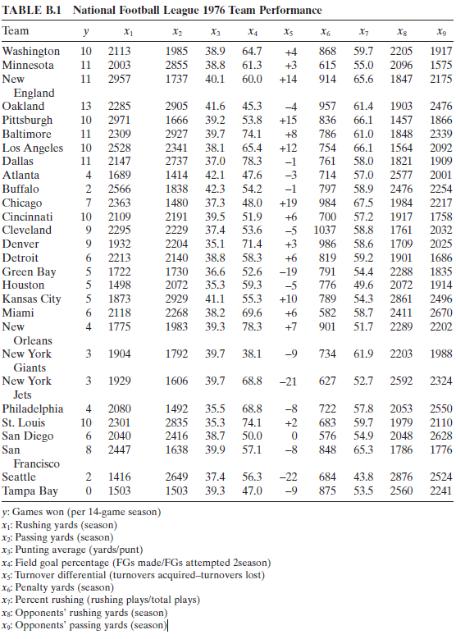
Demo

Slide 7
CODE walkthrough

Slide 8

Questions?

Slide 9
Thank you!

